Slide 1

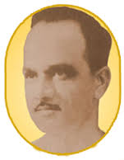
Anantrao Pawar College of Engineering & Research
Department of Computer Engineering
YOUTUBE VIDEO RECOMMENDATION BASED ON USER COMMENTS AND ITS STATISTICAL ANALYSIS
Akshay Jadhav(B151104211)
Utkarsha Patil(B151104226)
Aishwarya Jain(B151104213)
Vishal Satpute(B151104235)
Under the guidance of
Prof. Vijayendra Gaikwad
Notes:
1

Slide 2
CONTENTS
Introduction
Motivation & Scope
Literature survey
Existing System
Proposed System
Idea Matrix
Requirements
Feasibility study
NP-Complete
Mathematical model
UML diagrams
Cost estimation
Algorithms
Merits & Demerits
Testing
Expected flow of Project
References
Paper Publication Details

Slide 3
INTRODUCTION
YOUTUBE:
It’s a open video-sharing platform where user can upload,view, comment,like or dislike videos.
Users can upload an unlimited videos and add comments.
YouTube has enormous repository due to which exploration and discovery is a daunting task.
SENTIMENT ANALYSIS:
It’s a task of natural language processing which classifies documents into categories according to people's sentiments.
Useful in social media monitoring mood of consumers toward a application and determine whether they are viewed positively or negatively.
Here we are using YouTube comments to analyze the videos and for recommendation purpose.

Slide 4
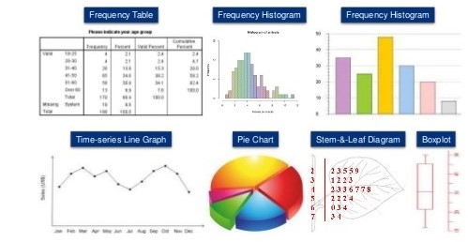
INTRODUCTION
STATISTICAL ANALYSIS:
Dealing with the collection, organization,
analysis, interpretation, and
presentation of data.
DATA ANALYTICS:
examining data sets in order to draw
conclusions.
Use of predictive models to gain valuable knowledge.
The insights from data are used to recommend action or to guide decision .
Figure 2:Statistical Analysis

Slide 5
MOTIVATION & SCOPE
MOTIVATION:
To refine the YouTube recommendations and provide users more relevant videos.
Current YouTube recommendation system is mostly based on watch history and search history
which is not sufficient for appropriate video recommendation.
SCOPE:
Videos will be recommended only if comments are present.
Analytics will be available to only the legitimate users.
Videos will be recommended to other user only if comments are inferring positive response.

Slide 6
LITERATURE SURVEY
NO. | YEAR | IEEE PAPER | WORK DESCRIPTION
1. | 2017 | Mining Trailers Data from YouTube for predicting Gross Income of Movies | Data regarding the trailers of a movie from YouTube can provide useful insights for predicting the gross income of movies. The dataset contains different attributes like opening income, number of views, number of likes, number of dislikes, number of comments. The comparative analysis on this attributes to predict movies gross income
2. | 2017 | Retrieving YouTube video by Sentiment Analysis on User Comment | Sometimes irrelevant and low quality videos ranked higher in the search result due to the number of views or likes, which seems untenable. To minimize this issue, we present a Natural Language processing (NLP) based sentiment analysis approach on user comments. This analysis helps to find out the most relevant and popular video of YouTube according to the search.

Slide 7
LITERATURE SURVEY
NO. | YEAR | IEEE PAPER | WORK DESCRIPTION
3 | 2016 | Deep Neural Networks for YouTube Recommendations | The paper is split according to the classic two-stage information retrieval dichotomy: a deep candidate generation model and then describe a separate deep ranking model.Practical lessons and insights derived from designing,iterating and maintaining a massive recommendation system
4 | 2015 | Sentiment Analysis on YouTube: A Brief Survey | This paper presents a brief survey of techniques to analyze opinions posted by users about a particular video.
5 | 2010 | A Recommender System for YouTube Based on its Network of Reviewers | to extract information about video relationship using a network formed from comments in YouTube videos. create a network of videos called YouTube Recommender Network (YRN) and use complex network analysis on this network as the basis of a recommender system.

Slide 8
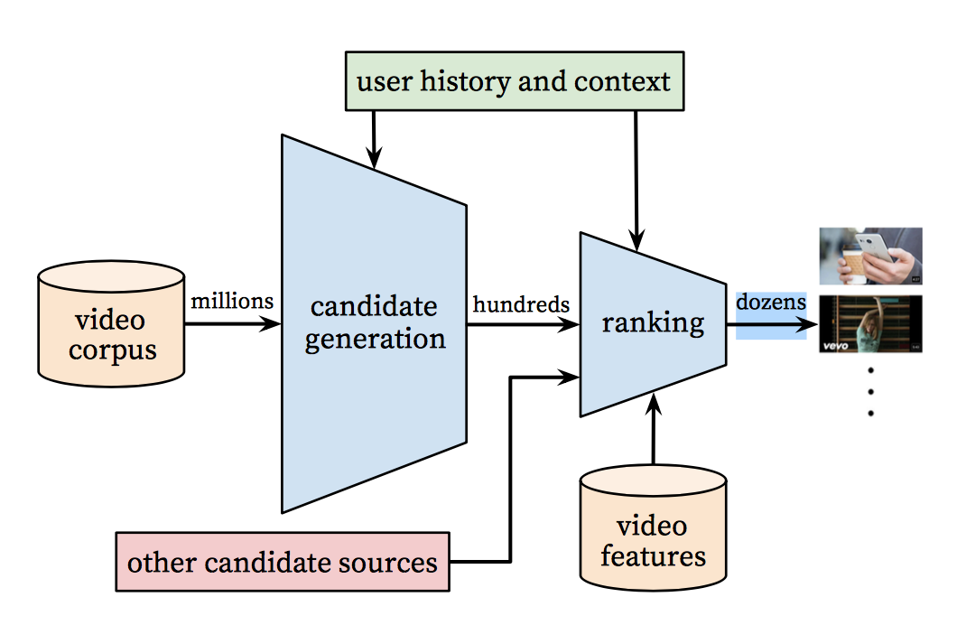
EXISTING SYSTEM
Current personalized recommendation
system of YouTube is based on user watch
and search history which is not adequate
factor for most appropriate suggestion.
figure1:working of recommendation system

Slide 9
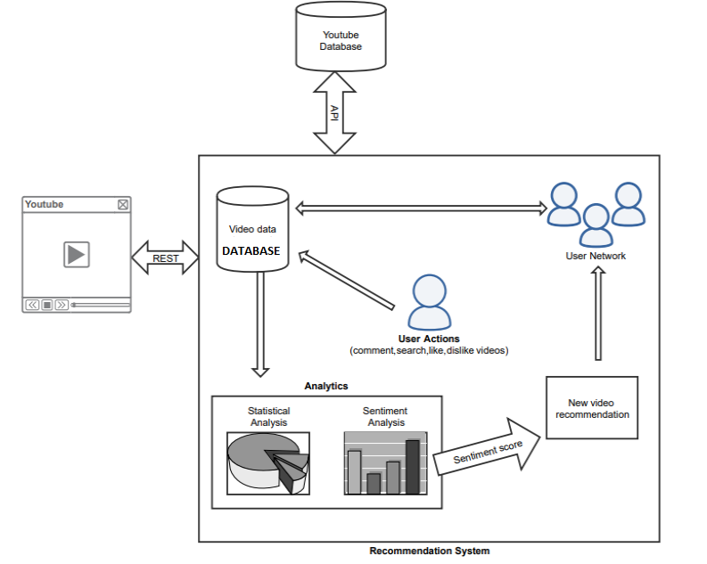
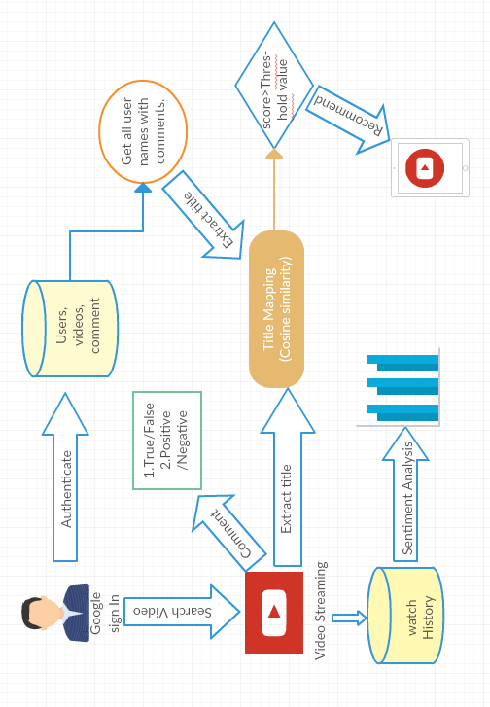
PROPOSED SYSYEM

Slide 10
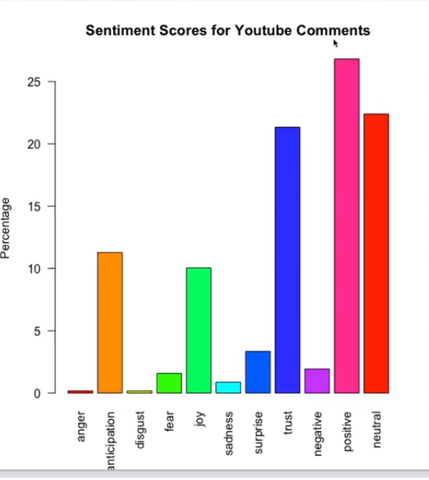
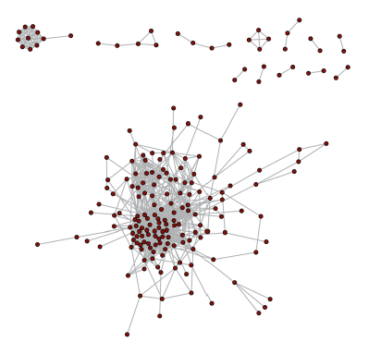
PROPOSED SYSYEM
Creating statistics from collected data
NETWORK FORMATION USING COMMENTS
Creating statistics from collected data:

Slide 11
IDEA MATRIX
I | D | E | A
Increase: Efficiency of video recommendation system | Drive: Provide relevant videos, Include new ideas in project and security measurement. | Educate: User of system, end user ,privacy management. | Accelerate: Data access ,processing and time complexity.
Improve: Current YouTube recommendation system. | Deliver: Appropriate video recommendation. | Evaluate: Formation of user-node graph based on user comments. | Associate: End users with application.
Ignore: Not relevant competitive parameter. | Decrease: Irrelevant video suggestion to the user, Human error. | Eliminate: Resource dependency and other factor affecting system. | Avoid: Misuse, manipulated result , redundancy.

Slide 12
REQUIREMENTS
SOFTWARE REQUIREMENTS:
Editor:STS 3,MySQL,JDK .
GUI: CSS, Bootstrap.
HARDWARE REQUIREMENTS:
8 GB RAM
i5 processor
1GB Hard Disk

Slide 13
FEASIBILITY STUDY
ECONOMIC FEASIBILITY:
Implementation of open platform resources.
Estimated cost of overall project is negligible/low.
TECHNICAL FEASIBILITY:
Extending functionality of existing system.
Implementation of simple techniques.
OPERATIONAL FEASIBILITY:
Maintains privacy and security of data.
Minimum computation time.
ORGANIZATIONAL FEASIBILITY:
Enhanced recommendation of videos.
Data analysis for insights.

Slide 14
NP-COMPLETE
If we know how to solve problem X , it is possible to reduce Y to X and solve it quickly.
It should be possible to reduce Y to X in polynomial time.
Similarly ,we are using the already implemented YouTube application to enhance its video recommendation system.
We can reduce our new approach of recommendation to already existing solution of the video recommendation problem. Hence, our problem lies in NP-complete space.

Slide 15
MATHEMATICAL MODEL
System Description:
System:-Input,Output,Function,Success,Failure
Input:-Comments and replies to videos, likes, dislikes and views of videos.
Output:-User gets appropriate video recommendation for related topic.
Functions:-
YoutubeAPI: For identifying YouTube user.
Stanford CoreNLP: Obtain sentiment scores
Cosine similarity : Mapping of video title

Slide 16
MATHEMATICAL MODEL
Success Conditions:-
If any user in the network is commenting on similar topic video that video is recommended to all users in same network.
Failure Conditions:-
If user doesn't comment on interested video so related topic video is not recommended to that user.
If there is no comment or negative comment.

Slide 17
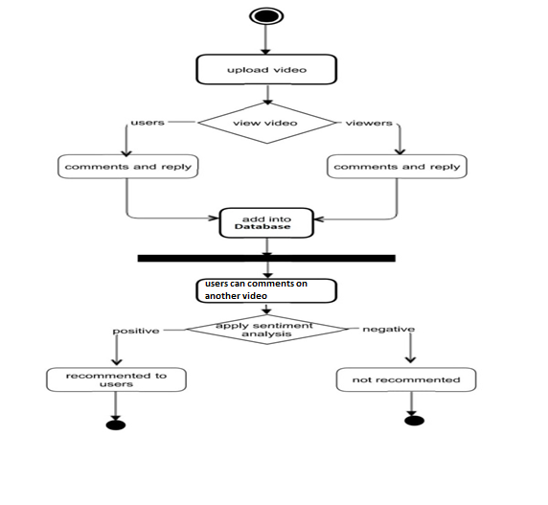
ACTIVITY DIAGRAM

Slide 18
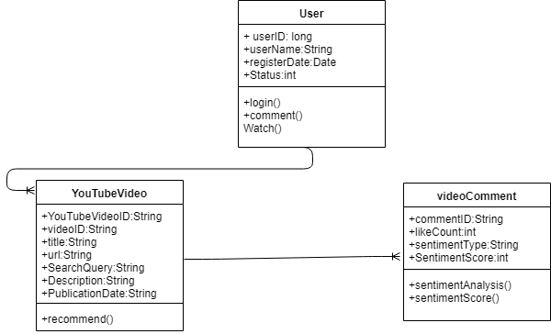
CLASS DIAGRAM

Slide 19
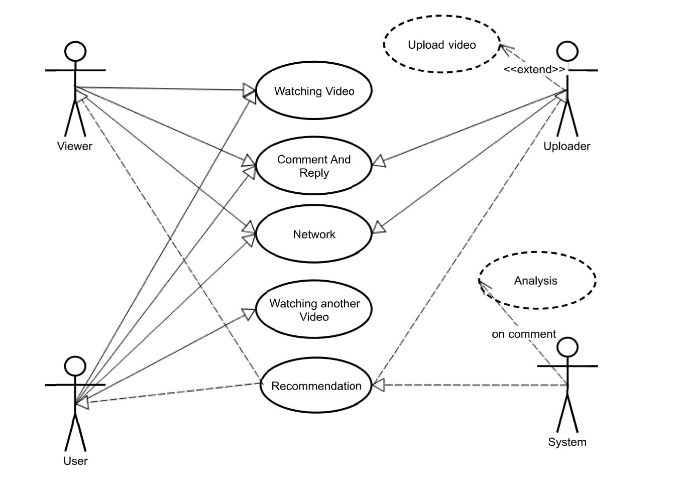
USE CASE DIAGRAM

Slide 20
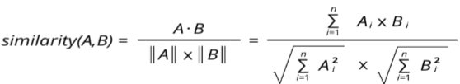
ALGORITHMS
Cosine Similarity:
Cosine similarity is the cosine of the angle between two n-dimensional vectors in an n-dimensional space. It is the dot product of the two vectors divided by the product of the two vectors’ lengths (or magnitudes).
We can use the Cosine Similarity algorithm to work out the similarity between two things. We might then use the computed similarity as part of a recommendation query
Cosine similarity is computed using the following formula: Values range between -1 and 1, where -1 is perfectly dissimilar and 1 is perfectly similar.

Slide 21
ALGORITHMS
Calculation of sentiment score(Stanford CoreNLP):
It can give the base forms of words, their parts of speech, whether they are names of companies, people, etc., normalize dates, times, and numeric quantities, mark up the structure of sentences in terms of phrases and syntactic dependencies, indicate which noun phrases refer to the same entities, indicate sentiment, extract particular or open-class relations between entity mentions, get the quotes people said, etc.
Following Annotator class names (methods) are use in above algorithm:
tokenize: Tokenizes the text.. The tokenizer saves the character oﬀsets of each token in the input text, as CharacterOﬀsetBeginAnnotation and CharacterOﬀsetEndAnnotation.
Annotator class name:TokenizerAnnotator.

Slide 22
ALGORITHMS
ssplit: Splits a sequence of tokens into sentences. (In current CoreNLP, sentence splitting comes after tokenization, and exploits the decisions of the tokenizer.)
Annotator class name: WordsToSentenceAnnotator.
Sentiment: StanfordCoreNLP includes the sentiment tool and various programs which support it. The model can be used to analyze text as part of StanfordCoreNLP by adding sentiment to the list of an-notators.
Annotator class name: SentimentAnnotator

Slide 23
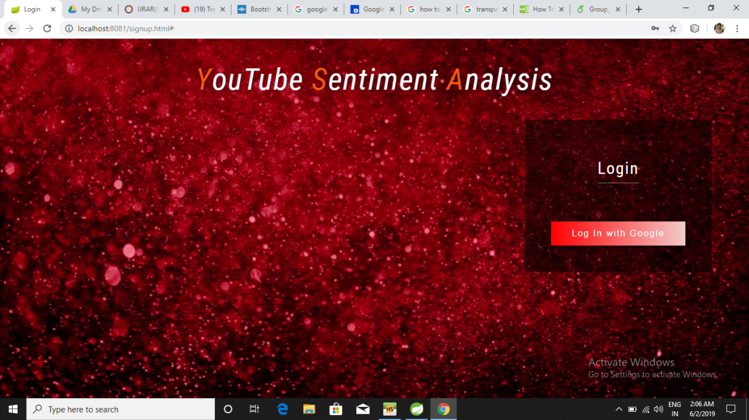
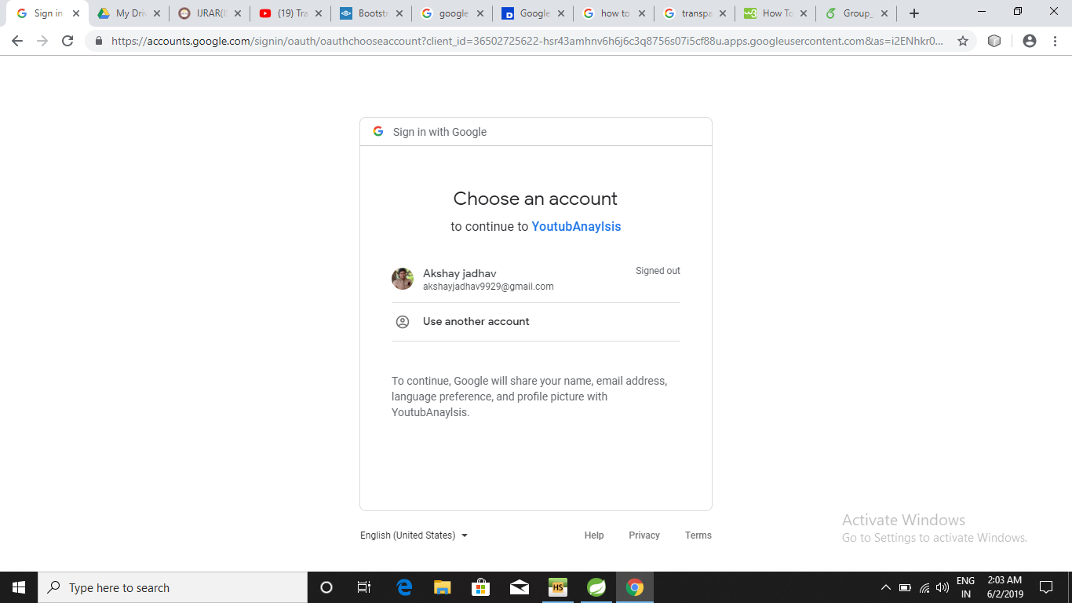
IMPLEMENTATION WORK
Homepage
Google_sign_in

Slide 24
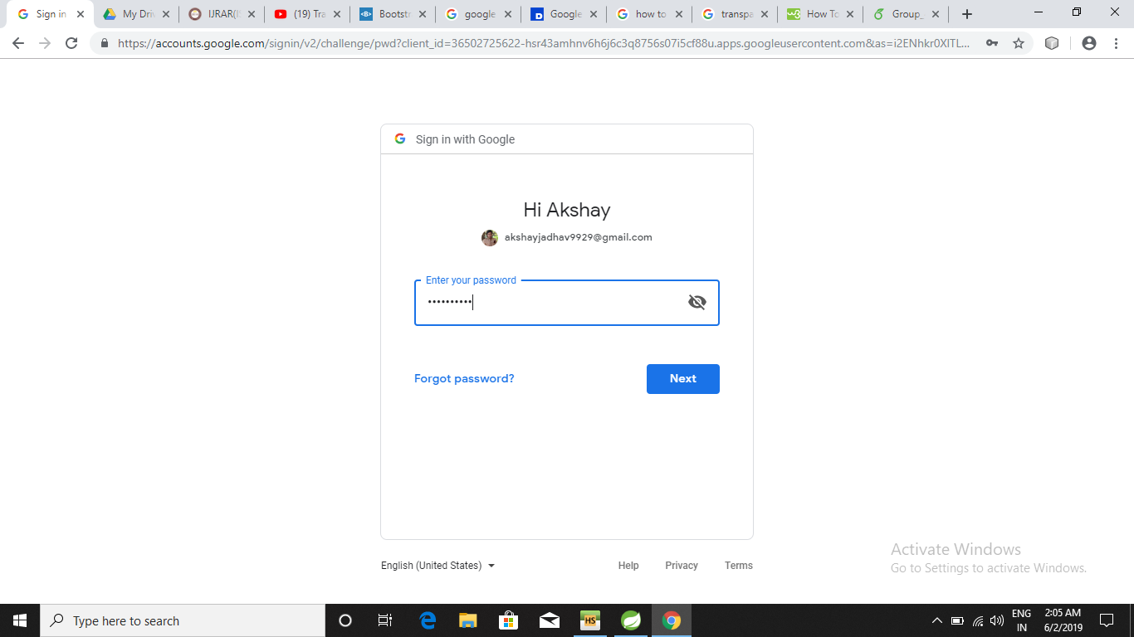
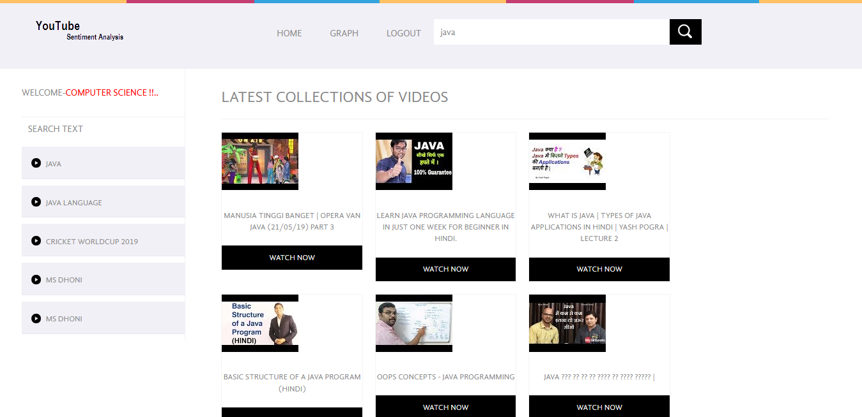
IMPLEMENTATION WORK
Credentials
Search_Query

Slide 25
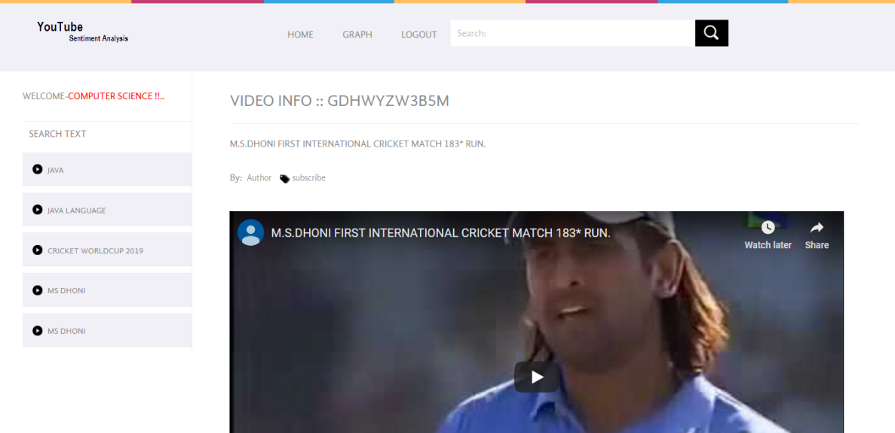
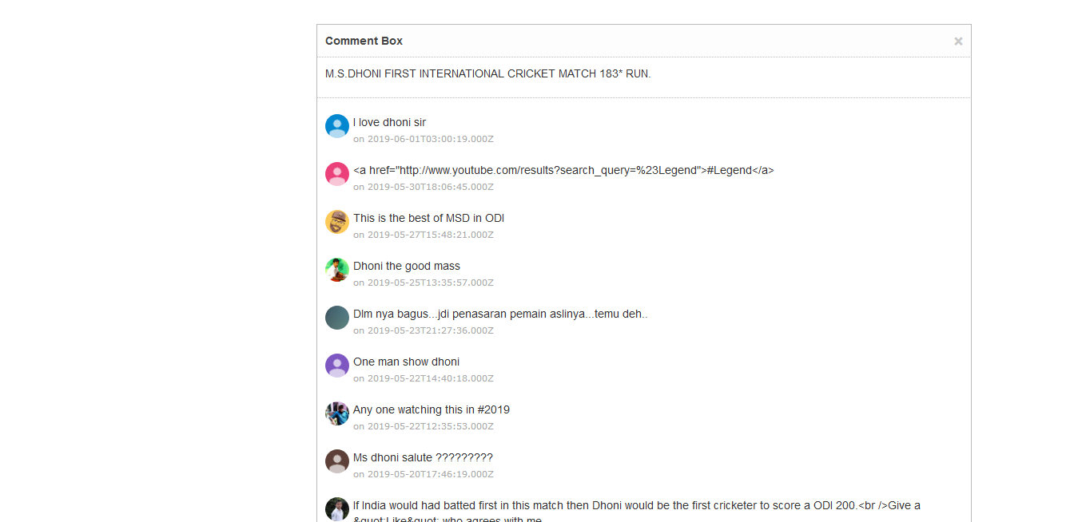
IMPLEMENTATION WORK
Video_streaming
Comments

Slide 26
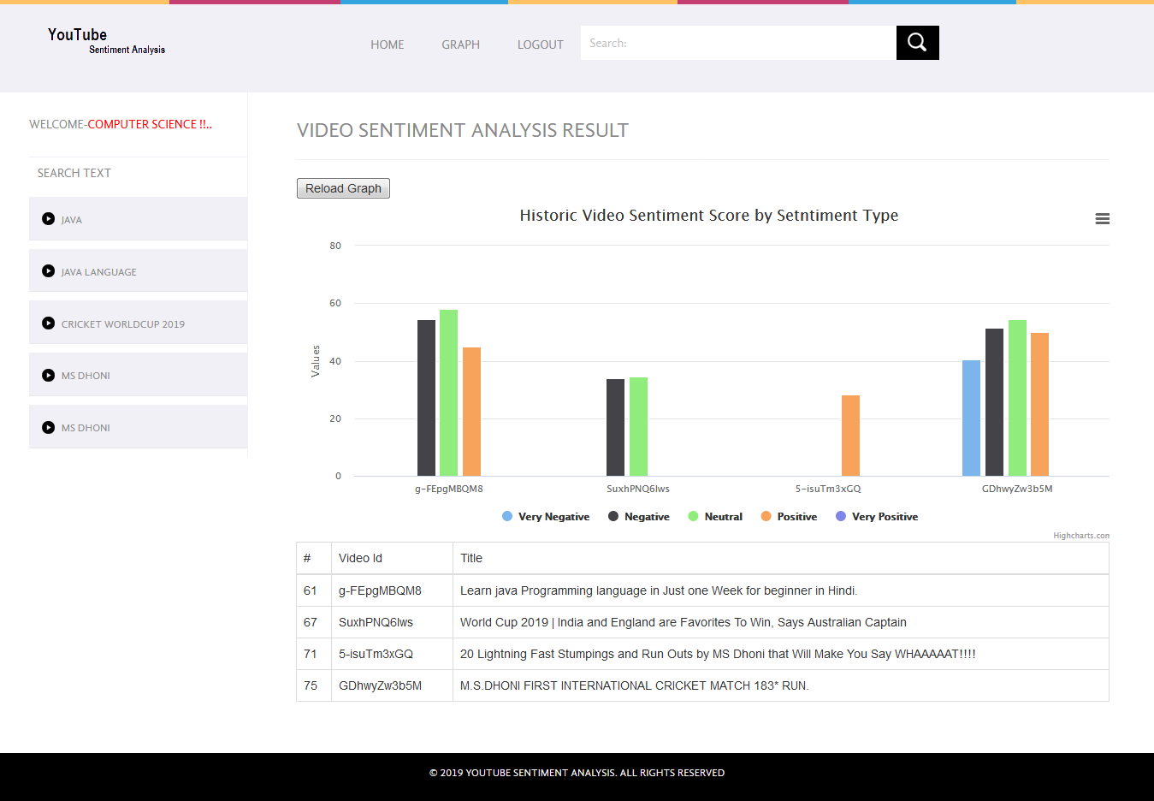
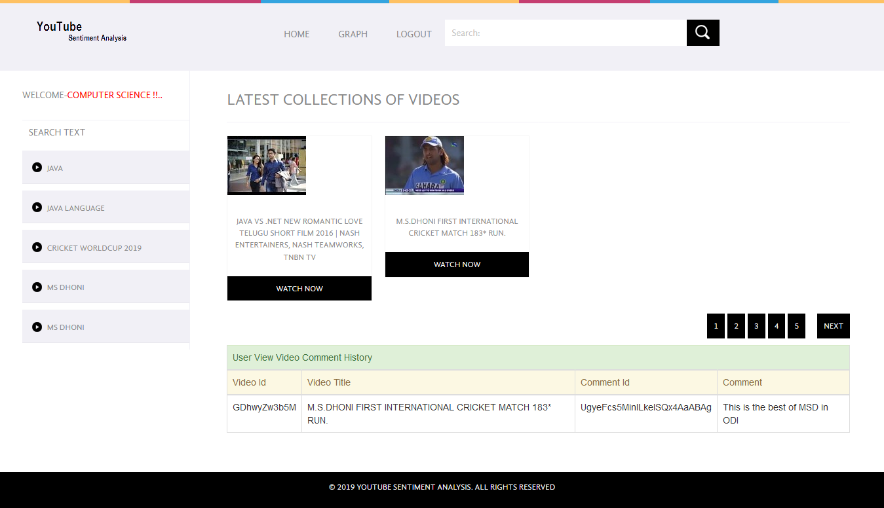
IMPLEMENTATION WORK
Sentiment_analysis
Recommendation

Slide 27
COST ESTIMATION
As we are using all the open source platform project cost is negligible.
SOFTWARE COST ESTIMATION
DETAILS |  |  |  | THREE-POINT COST ESTIMATION |  |  | WEIGHTED AVERAGE | ADDITIONAL INFORMATION
DATE | ITEM DESCRIPTION | GATHERED BY | QUANTITY | BEST CASE | MOST-LIKELY/REALISTIC | WORST-CASE
 | YOUTUBE API KEY | Aishwarya | 1 | Free | Free | Free | NULL | https://console.developers.google.com
 | R Studio | Akshay | 1 | Free | Free | Free | NULL | Available online on http://www.rstudio.com/
 | Neatbeans | Vishal | 1 | Free | Free | Free | NULL | Available online on https://netbeans.org/downloads/
HARDWARE COST ESTIMATION
DETAILS |  |  |  | THREE-POINT COST ESTIMATION |  |  | WEIGHTED AVERAGE | ADDITIONAL INFORMATION
DATE | ITEM DESCRIPTION | GATHERED BY | QUANTITY | BEST CASE | MOST-LIKELY/REALISTIC | WORST-CASE
 | Computer | Utkarsha | 1 | 40000 | 45000 | 70000 | 52000 | Available On Online Shopping Websites

Slide 28
MERITS & DEMERITS
MERITS:
User will get most appropriate video recommendation using user comment.
Only interested users will receive the recommendation , hence avoiding irrelevance.
Network formation between users using their comment .
User is unaware of formation of network.so user comments are always excepted to be genuine.
Sentiment analysis will provide more insights of the data.
DEMERITS:
Recommendations may not be accurate all the time.
User comment must be always positive or neutral.

Slide 29
Testing
.
youtube test case.docx

Slide 30
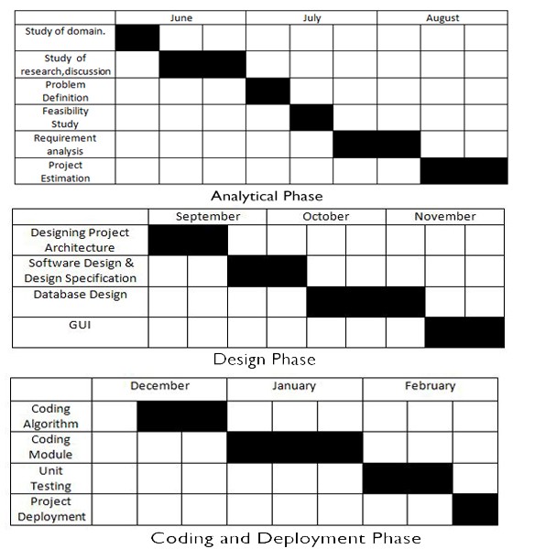
WORK FLOW
Analytical phase
Design phase

Slide 31
REFRENCES
[1]Rahim, M. S., Chowdhury, A. Z. M. E., Islam, M. A., & Islam, M. R. (2017). Mining trailers data from youtube for predicting gross income of movies. 2017 IEEE Region 10 Humanitarian Technology Conference (R10-HTC).
[2] Bhuiyan, H., Ara, J., Bardhan, R., & Islam, M. R. (2017). Retrieving YouTube video by sentiment analysis on user comment. 2017 IEEE International Conference on Signal and Image Processing Applications (ICSIPA).
[3] Paul Covington, Jay Adams, Emre Sargin. Deep Neural Networks for YouTube Recommendations. Published 2016 in RecSys.
[4] Muhammad Zubair Asghar, Shakeel Ahmad, Afsana Marwat, Fazal Masud Kundi. Sentiment Analysis on YouTube: A Brief Survey.2015.
[5]Song Qin, Ronaldo Menezes, Marius Silaghi,"A Recommender System for YouTube Based on its Network of Reviewers",in IEEE International Conference on Privacy, Security, Risk and Trust,30 September 2010

Slide 32
PAPER PUBLICATION DETAILS
Unique Identification Number - IJRAR1904502
Paper ID - 192437
Page Number(s) - 12-16
Published in - Volume 5 | Issue 4 | October 2018
Publisher Name - IJRAR | www.ijrar.org | E-ISSN 2348-1269, P- ISSN 2349-5138
Citation:
Akshay Nandkishor Jadhav, Utkarsha Ajay Patil, Aishwarya Dhanraj Jain, Vishal Lahu Satpute, "YOUTUBE VIDEO RECOMMENDATION BASED ON USER COMMENTS AND ITS STATISTICAL ANALYSIS", IJRAR - International Journal of Research and Analytical Reviews (IJRAR), E-ISSN 2348-1269, P- ISSN 2349-5138, Volume.5, Issue 4, Page No pp.12-16, October 2018, Available at : http://www.ijrar.org/IJRAR1904502.pdf
SEM1_paper\IJRAR1904502.pdf

Slide 33
PAPER PUBLICATION DETAILS
Unique Identification Number-IJRAR_204477
Paper ID - 204477
Page Number(s) -
Published in -
Publisher Name - IJRAR | www.ijrar.org | E-ISSN 2348-1269, P- ISSN 2349-5138
Citation:
Akshay Nandkishor Jadhav, Utkarsha Ajay Patil, Aishwarya Dhanraj Jain, Vishal Lahu Satpute,

Slide 34
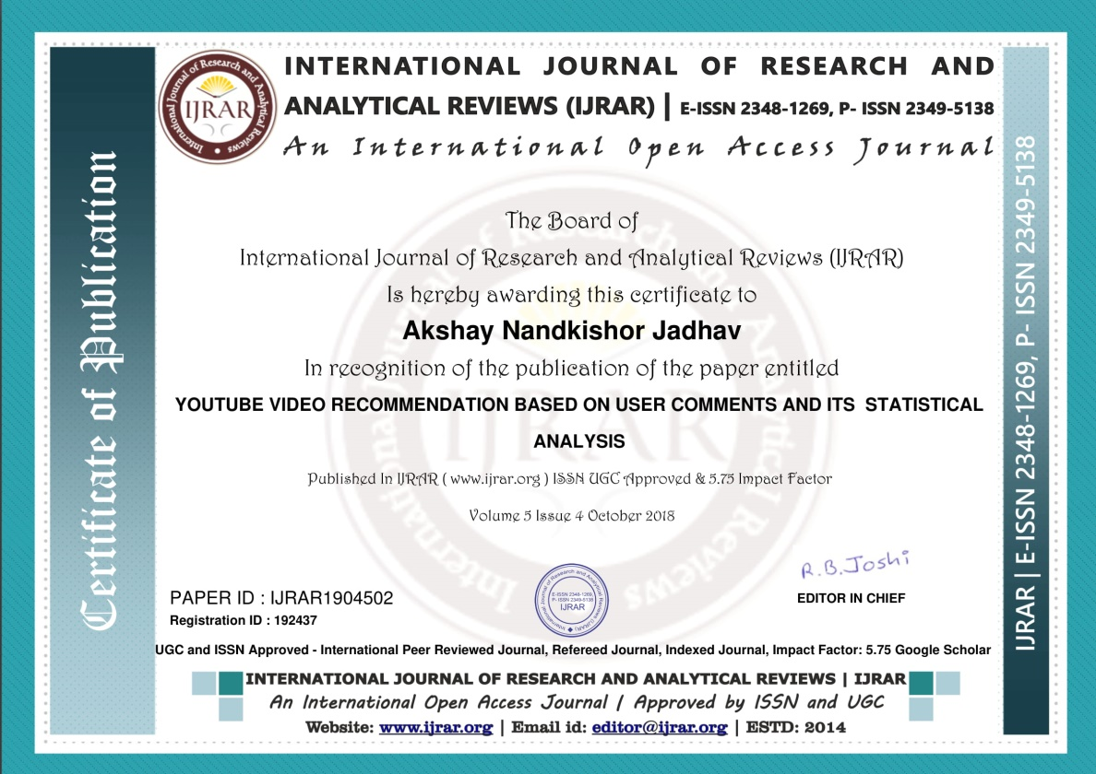
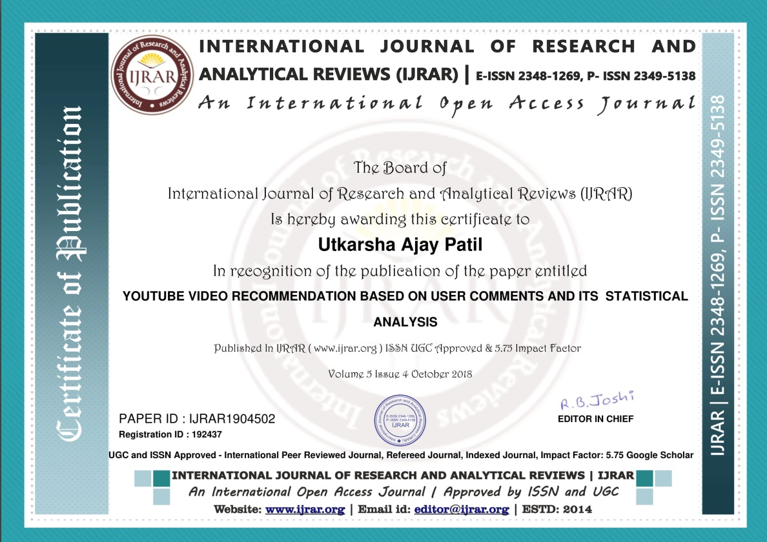
PAPER CERTIFICATE(SEM 1)

Slide 35


PAPER CERTIFICATE(SEM 1)

Slide 36


PAPER CERTIFICATE(SEM 2)

Slide 37


PAPER CERTIFICATE(SEM 2)

Slide 38

PAPER CERTIFICATE(SEM 2)

Slide 39


